Slide 1

Heart Disease Prediction
Using Machine Learning

Slide 2

Problem Statment
Despite advancements in healthcare, heart disease remains a leading cause of mortality worldwide. Developing an accurate predictive model is crucial for early detection and intervention, particularly in identifying high-risk individuals based on key demographic and health-related factors

Slide 3




Data Cleaning and Preprocessing
Prepare the data for analysis by handling missing values, outliers, and ensuring consistency
KEY
STEPS
Exploratory Data Analysis (EDA)
Explore the dataset to understand the distribution, relationships, and key statistics.
Feature Engineering amd Model Building
Create new features that may help improve the prediction accuracy. Develop and train machine learning models to predict heart disease.
Model Evaluation
Evaluate models using accuracy, precision, recall, F1 score, and ROC-AUC, compare them to select the best-performing one, and perform hyperparameter tuning to optimize performance.
4o

Slide 4












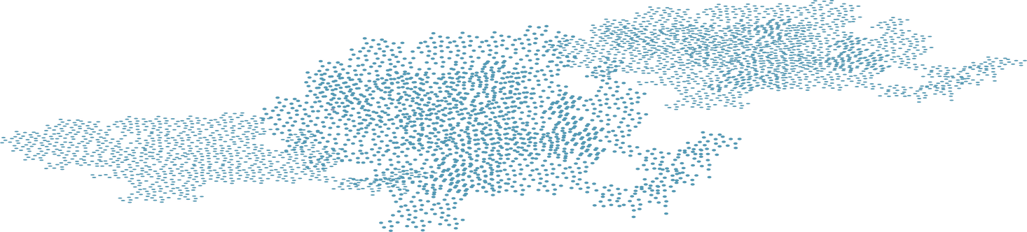
Modeling
Using Logistic Regression, Decision Tree, Random Forest, and XGBoost.
Exploratory Data Analysis (EDA)
Performing descriptive statistics, distribution analysis (histograms and box plots), correlation analysis (heatmaps), and group comparisons to analyze incidence across demographics in the dataset.
STEP 5
Data Acquisition
STEP 3
The dataset, sourced from Kaggle, comprises 1,000 samples with 16 features and is labeled for the presence of heart disease as a two-class dataset.
STEP 6
STEP 1
Model Evaluation
Models Evaluation was done using f1 score, precision, Recall, accuracy and confusion matrics to choose the best model
STEP 4
STEP 2
Feature Engineering
Data Preprocessing
Creating new features (e.g., Log Blood Pressure), combining features (interaction terms, composite features), and utilizing domain knowledge to include meaningful medical insights-based features. We now have 21 features
MODEL
Balancing the dataset to prevent bias towards the majority class, removing duplicates and outliers, and standardizing and normalizing the data to ensure it is on a similar scale.

Slide 5

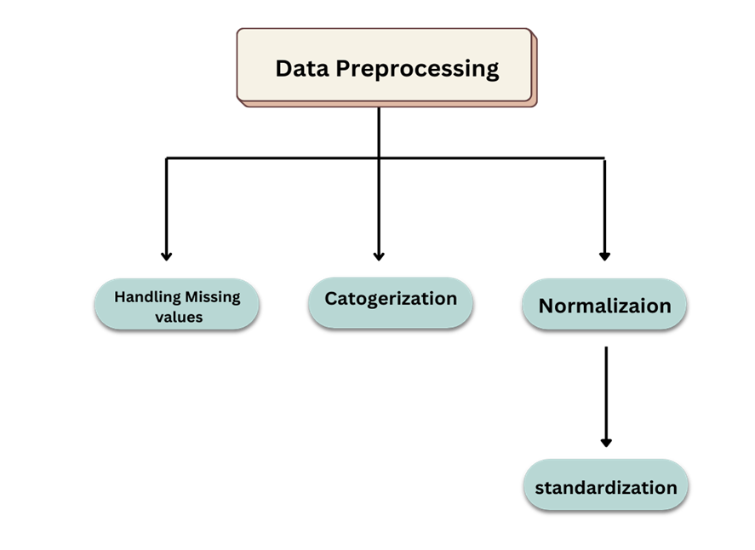
Model Cleaning and Preprocessing

Slide 6




EXPLORATORY DATA ANALYSIS
01
Histogram Feature Analysis
02
Histogram Feature
Analysis (after preprocessing)
03
Mean, median, mode, std
statistical Analysis
04
Correlation Heatmap
05
Group Comparison

Slide 7

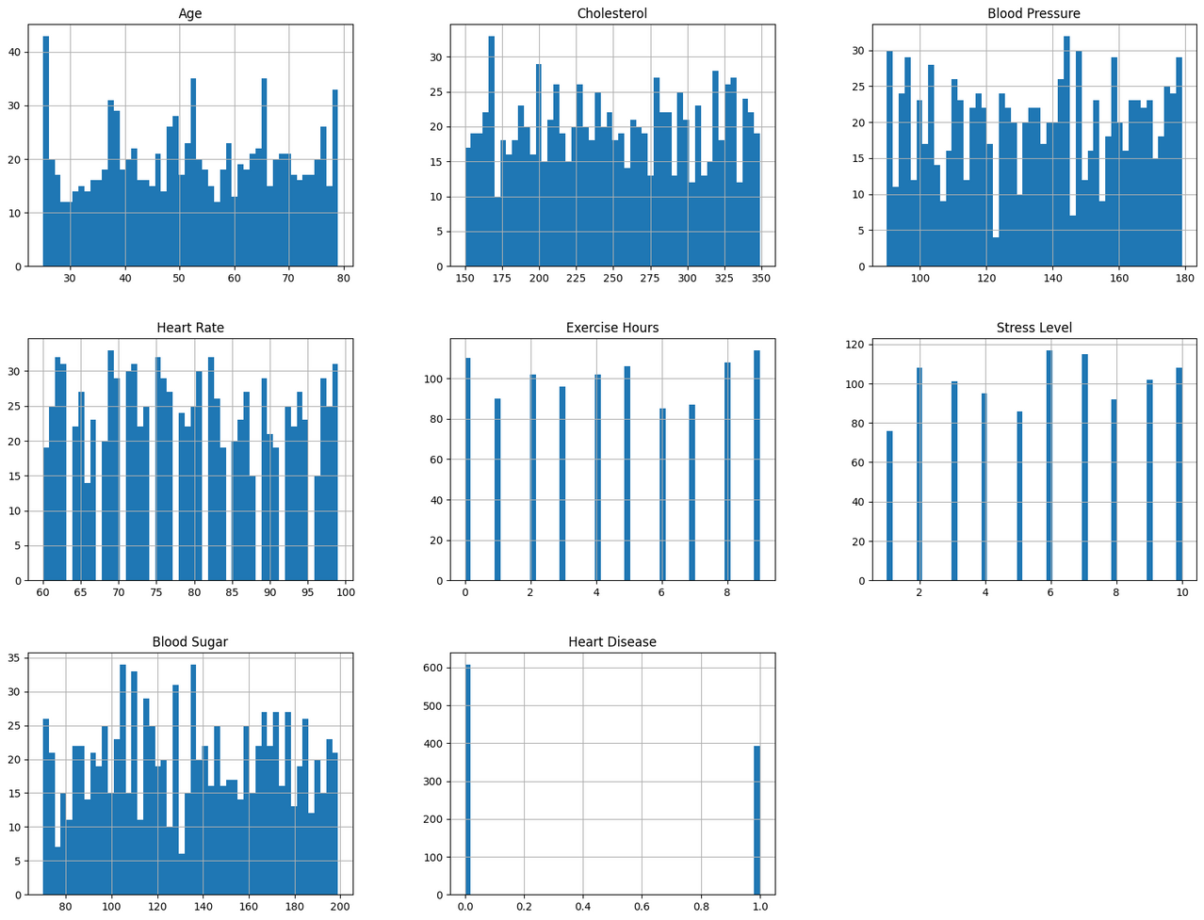
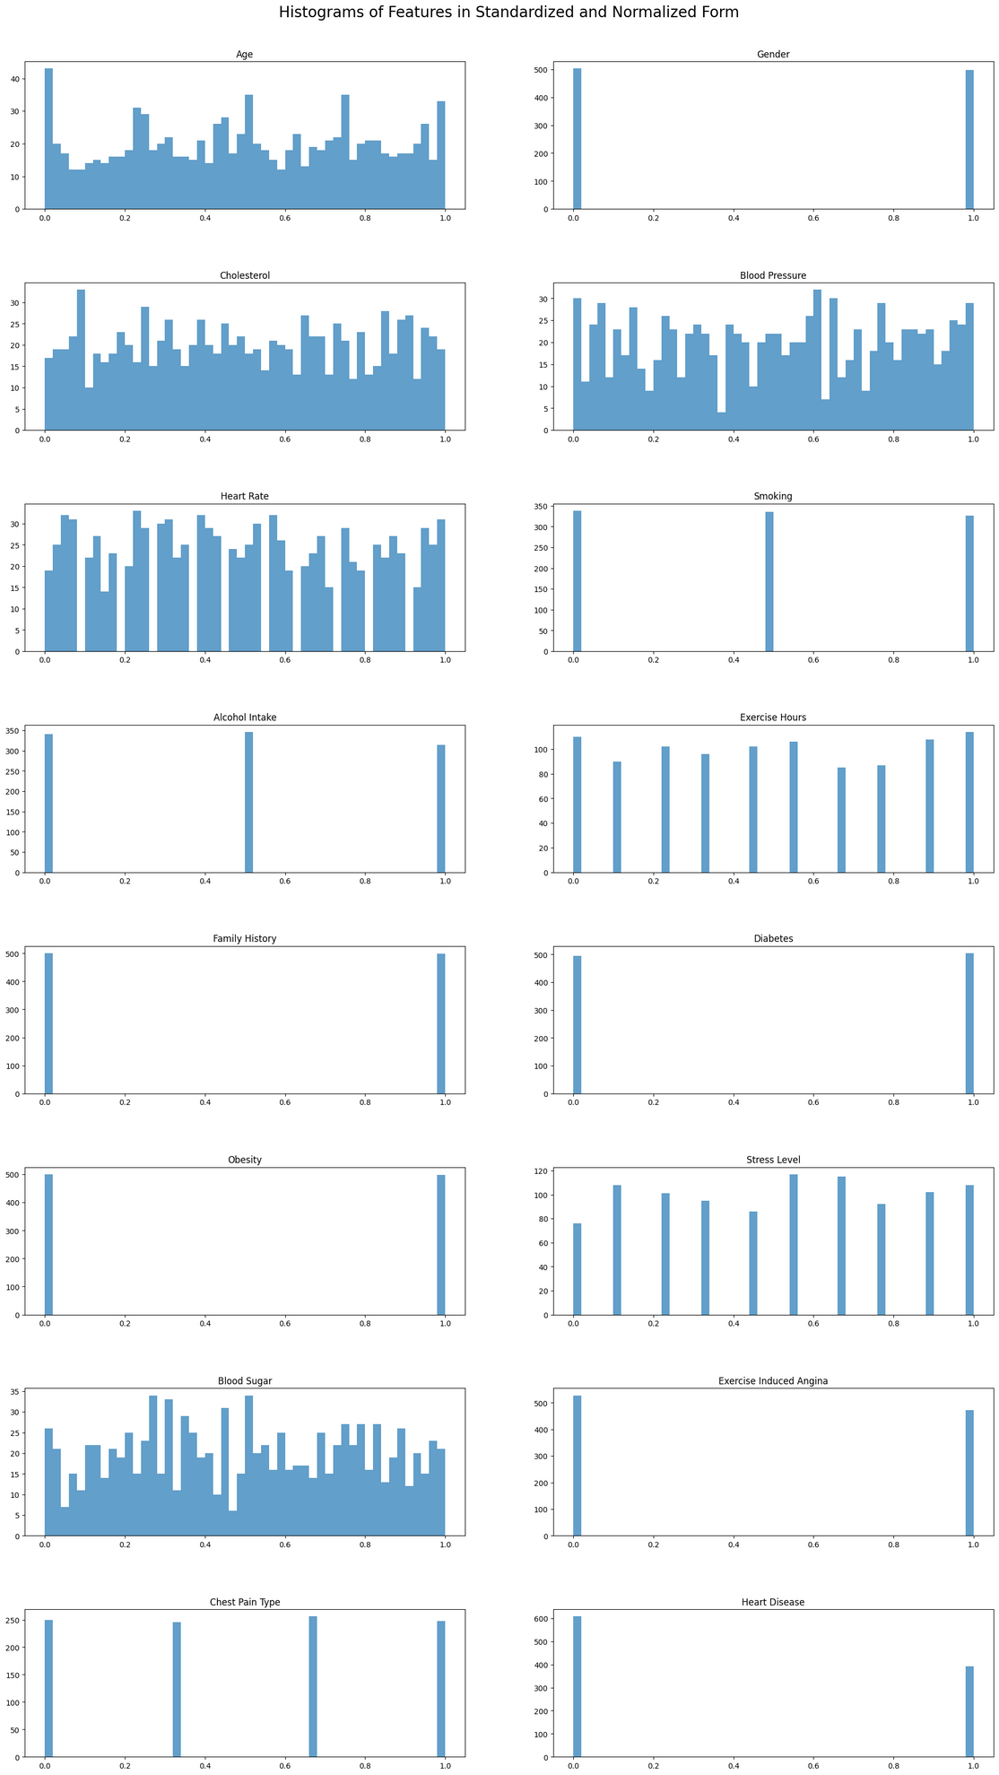
Before Normalization
After Normalization

Slide 8
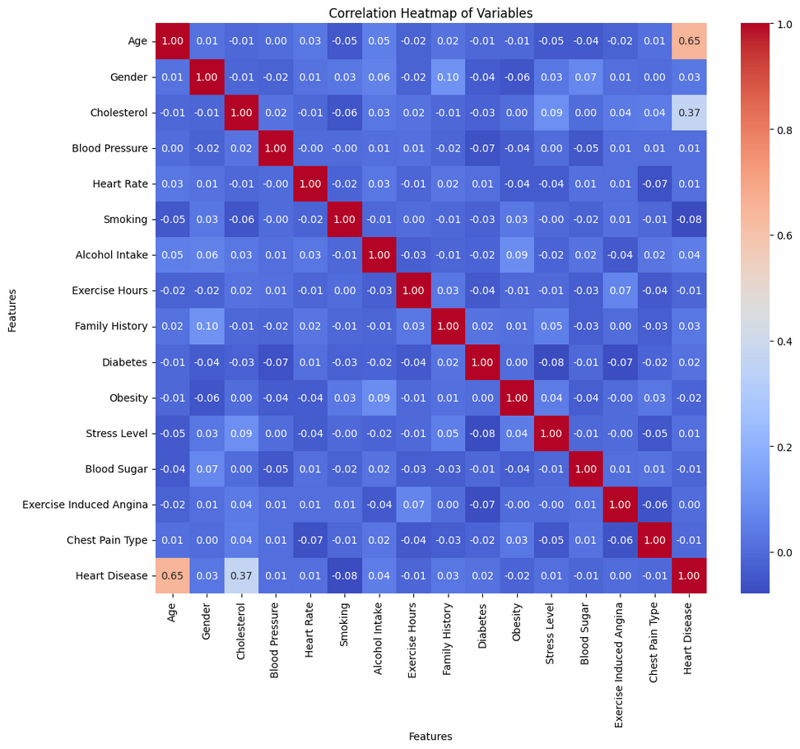
CORRELATION HEATMAP
Cholesterol and Heart Disease: It shows moderate positive correlation with value 0.37
Age and Heart Disease: light red color shows positive correlation between two variables with value 0.65
Smoking and Heart Disease: It shows negative correlation

Slide 9
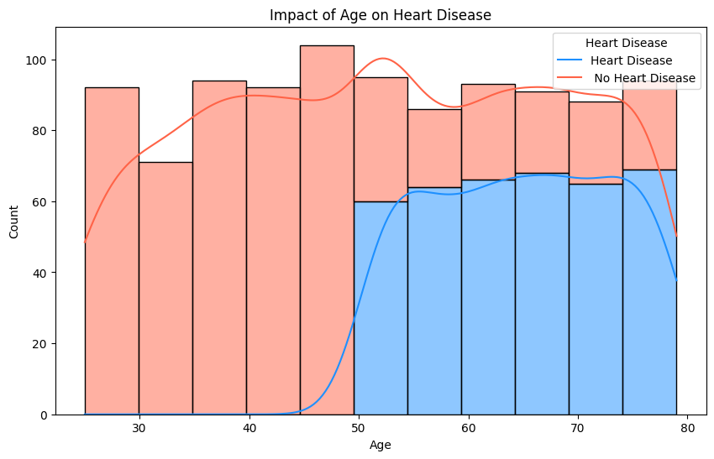
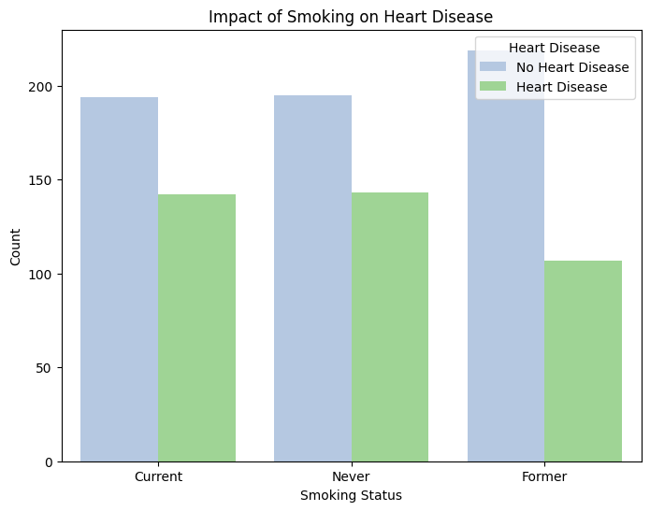
DEMOGRAPHIC COMPARISON
Impact of Age
Impact of Smoking
People older than 50 are at greater risk of Heart Disease
Age less than 50 have less count of people with Heart Disease
Current Smokers have highest count of people with heart disease
Former smokers have highest count of people with no heart disease

Slide 10
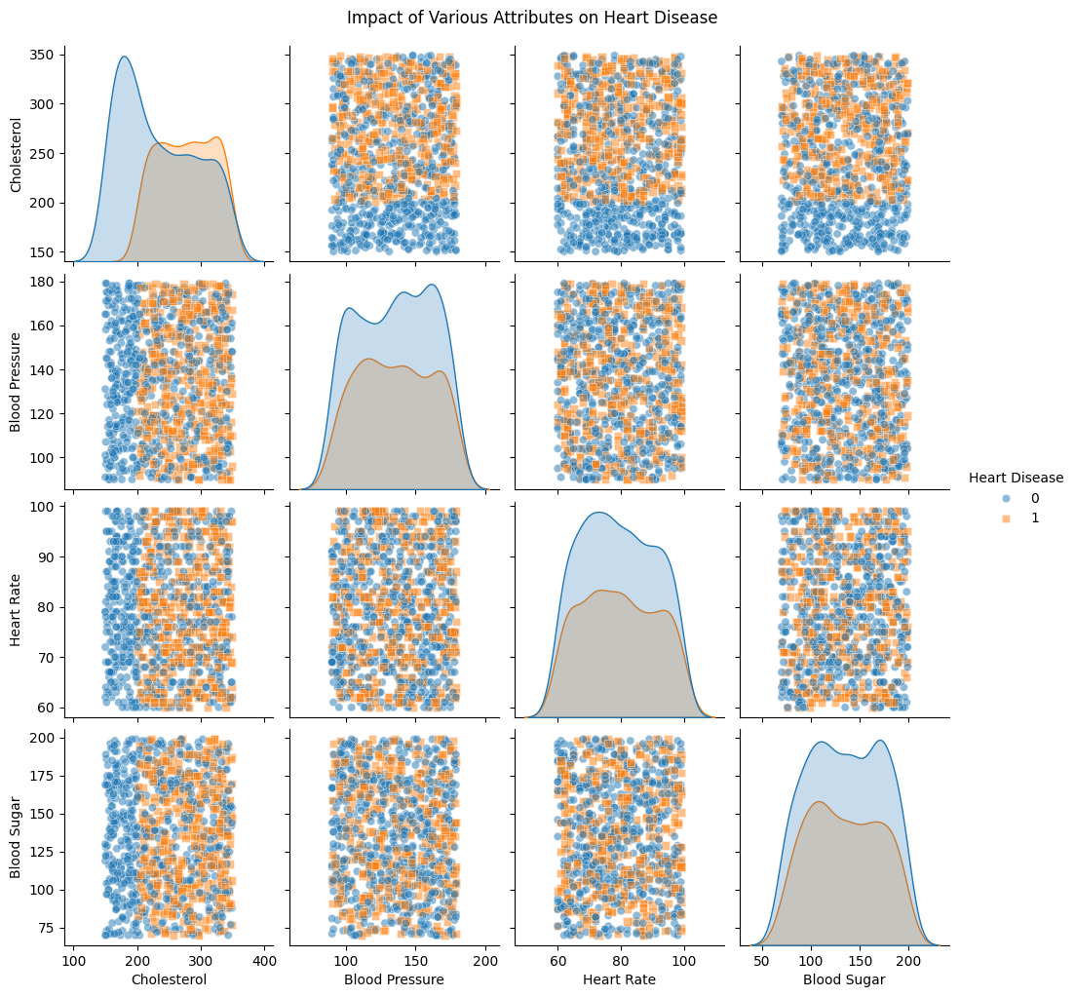
MEDICAL HISTORY
How to read non diagonal Plots?
Vertical Separation: Indicates the y-axis variable
important for distinguishing between categories.
Horizontal Separation: Indicates the x-axis variable is important for distinguishing between categories
Equal Distribution: neither of the variables plotted in that scatter plot has a strong correlation with the target variable
Analysis
Cholesterol has blue high peek near 200 in diagonal plots showing highest density of people with no heart disease
Distribution of cholesterol with Blood Pressure, Heart Rate and Blood sugar in non-diagonal plots indicates the X-axis variables are strong indicator of heart disease

Slide 11



Feature Engineering
Interaction Terms
Cholestrol_BloodPressure
Exercise_Stress
New Features
Log Blood Pressure
Risk Score
Domain Specific Features
Cholestrol_ratio
Mean_Arterial Pressure

Slide 12

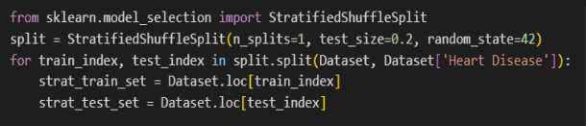
Training/spliting data
80/20 Ratio
Model Development
MODELS
DECISION TREE
RANDOM FOREST
XGBOOST
LOGISTIC REGRESSION

Slide 13


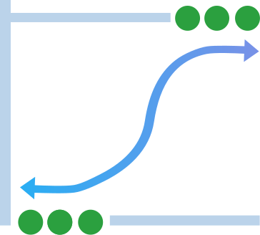

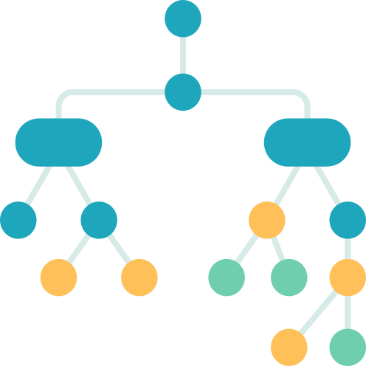
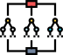
Model Building and Evaluation
Precision
Recall
F1 SCORE
Precision
STD
Accuracy
R(2)
MODELS
Logistic Regression
0.90
0.91
0.89
0.905
XGBoost
0.98
0.99
0.98
0.985
Decision Tree
0.99
1.00
0.98
0.995
Random Forest
0.99
1.00
0.98
0.995

Slide 14
Conclusion
Future Work
Random Forest and Decision Tree Outperforms other models giving us 99% Accuracy
Increasing the dataset to check whether our model works well
Chose Random Forest as it mitigate overfitting and work well on large dataset compared to Decision Tree
Ensemble Techniques such as stacking or deep learning models can be used for better accuracy for large Dataset
Explore deep learning for enhanced predictive accuracy in heart disease diagnosis and develop user-friendly diagnostic tools for healthcare professionals.

Slide 15
Recommendations
Healthcare professionals should prioritize cardiovascular screenings and preventive measures for patients over the age of 50. Regular check-ups, lifestyle counseling, and early intervention can help mitigate risks associated with aging
Emphasize smoking cessation programs for current smokers to reduce their risk of heart disease. For former smokers, focus on maintaining healthy habits to prevent recurrence of heart disease
Conduct comprehensive assessments that include blood pressure monitoring, heart rate evaluation, and blood sugar tests. Understanding these interrelationships can aid in early detection and tailored treatment plans for individuals at risk
Educate patients about the impact of age, smoking habits, and cholesterol levels on heart health. Encourage lifestyle modifications such as healthy diet choices, regular exercise, and stress management.

Slide 16

Thank You!

